Slide 1
Data Analyst Job Application Assignment @Funda
Author
Alet Terblanche-Whittington
23/06/2023

Slide 2
Main Insights
Data indicates that while content has grown, that content has not had the same level of engagement with customers. Rather customers remain engaged with a smaller set of the content.
Recommendation: new content could be tailored better to grow engagement across the customer base
Additional Insights
Documentaries have higher average ratings than other genres
Cohorts of users show between 70-80% drop in movie-rating participation after 1 year
Note: More frequent ratings by customers is taken as proxy indicator of “Engagement” with product

Slide 3
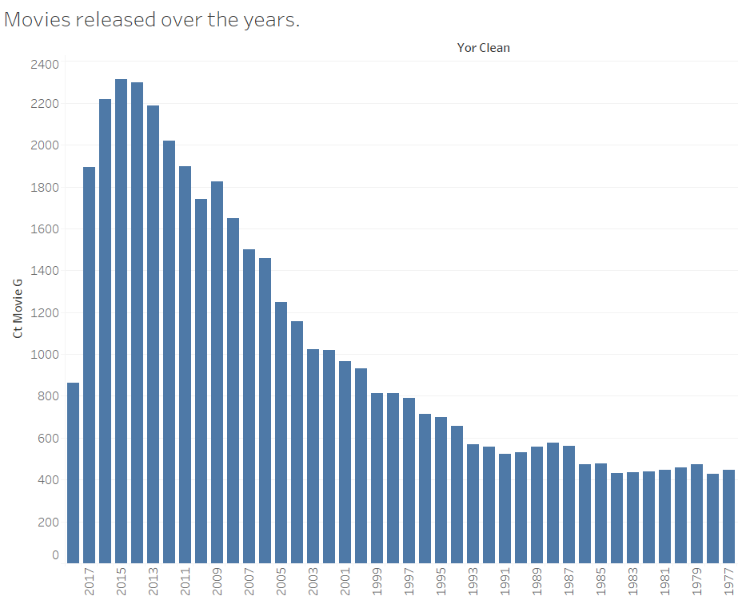
Content generally increase over time
Number of movies released over the years
Generally increasing in previous years
Recent 3 years show decline in movies being released
Count Movies
Year Released

Slide 4
Engagement over time fluctuates
Engagement = average # of ratings per customer
Notes:
select year_rate, count(movieid) ct_mov, count(distinct(userid)) ct_user, count(movieid)/count(distinct(userid)) ave_num_rating_p_cust from funda.a_ratings group by 1

Slide 5
Normalizing engagement for growth in content shows there is not broad growth of engagement in new content
Suggestion:
tailor content better for viewers to avoid wasting money on less engaging content
A decrease shows more overlap in the same movies being watched by different customers rather than different customers watching different content as it grows
Notes:
select year_rate, count(movieid) ct_mov, count(distinct(userid)) ct_user, (count(movieid)/count(distinct(userid)))/(count(distinct(movieid)))::float ave_num_rating_p_cust_norm from funda.a_ratings group by 1;

Slide 6
2013 Cohort users contributed 75.8% less to the rating of movies in 2014
Similar drop in the 2014 cohort
Question: are users churning off the service or becoming less engaged over time?

Slide 7
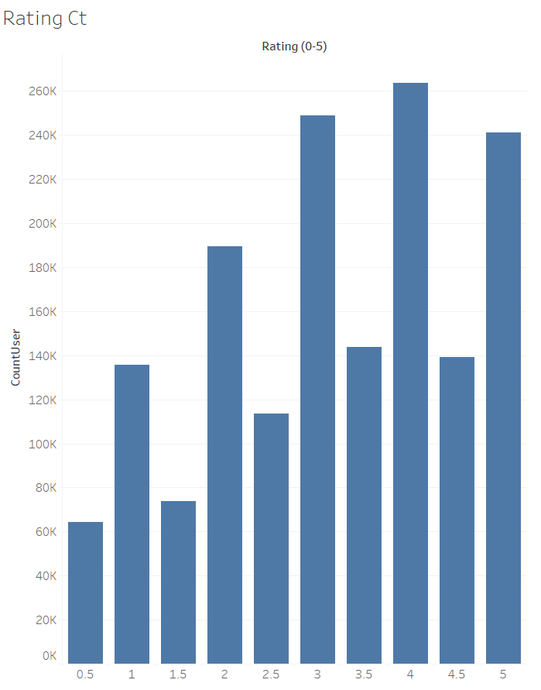
Rating values across dataset
Count of unique users’ rating values are monotonically increasing across the distribution
Preference for rating in whole numbers

Slide 8
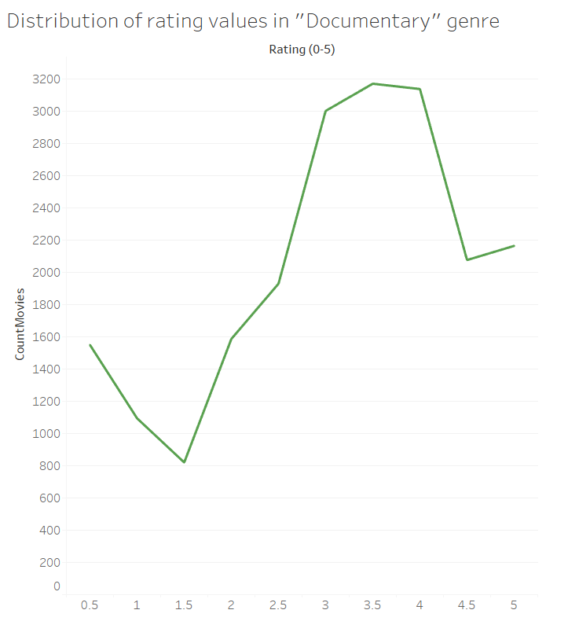
Documentaries low engagement but high ratings
Notes:
select a.genre, b.year_r, count(a.movieid) ct_mov, count(distinct(b.user_r)) ct_user, count(a.movieid)/count(distinct(b.user_r))::float ave_num_rating_p_cust
from funda.a_movies_all_genres a
left join (select userid user_r, movieid mov_r, year_rate year_r from funda.a_ratings) b
on a.movieid = b.mov_r
where genre = 'Documentary' and year_r is not null
group by 1,2;

Slide 9
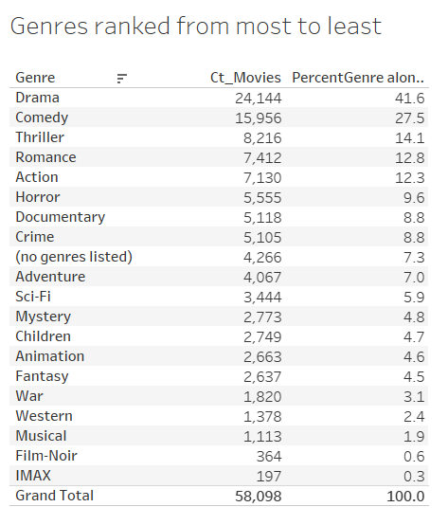
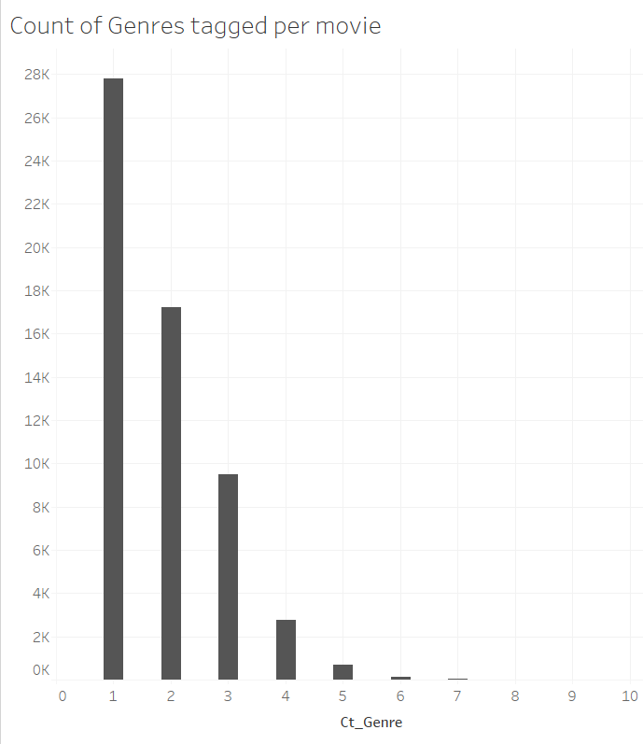
Genre overview
18 total genres
Max genres for a movie is 10
The largest number genres are Drama, Comedy, and Thriller making up 83.2% of total.
7.3% “not listed”
Notes:
-- How many genres are tagged per movie
select distinct(movieid), count(genre) from funda.a_movies_all_genres group by 1 order by 2 desc;

Slide 10
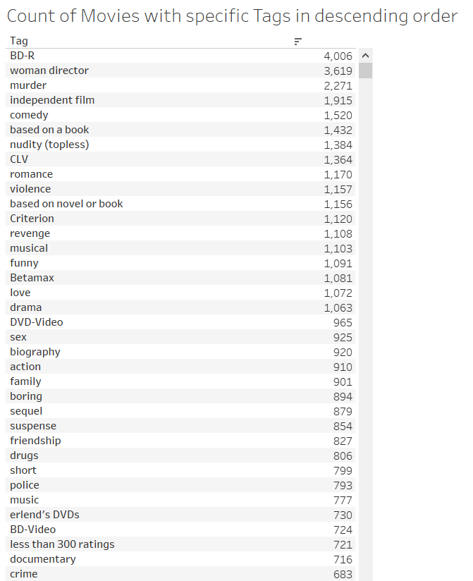
Terms tagged most
45,981 Movies tagged (79.1% of total)
BD-R = blue ray disc tagged between 2010-2017
41,455 Movies tagged
26,127 tagged pre-2018

Slide 11
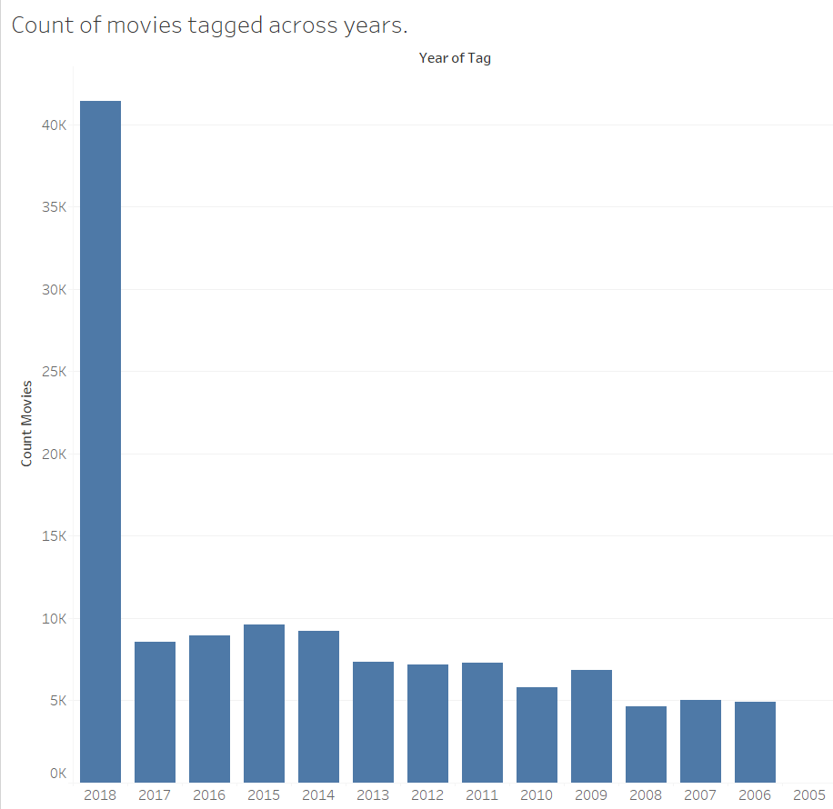
Tagging outliers
90.2% of tags occurred in 2018
Only one user with UserID “73406” tagged 39,152 in 2018
The same user rated only 1,865 movies between 2010-18
Question: is this a data or user error? More info needed.
Notes:
-- How many movies were tagged over time
select year_tag, count(distinct(movieid_t))
from funda.a_tags group by 1;

Slide 12
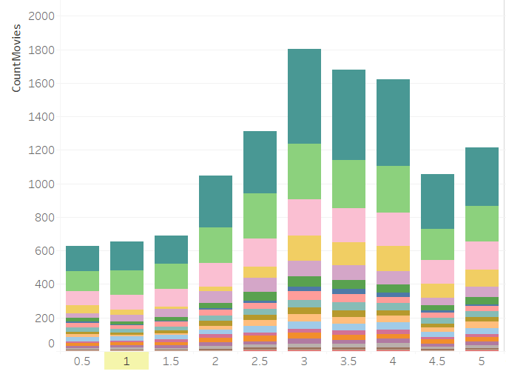
“Woman Director” tag
Ratings in 2018 of movies tagged as “woman director” with genres
Most movies in 2018 were tagged with “woman director”
Top five genres with this tag are Drama, Comedy, Romance, Documentary, and Thriller
Most ratings fall between 3-5
Drama
Comedy
Romance
Rating

Slide 13
APPENDIX

Slide 14
Additional Recommendations
Investigate UserID “73406” who tagged 39,152 in 2018 and rated 1,865 movies 2010-18.
Add geographic data to better determine location-based or native-language preferences.
Continue improving genre assignments of latest released movies

Slide 15
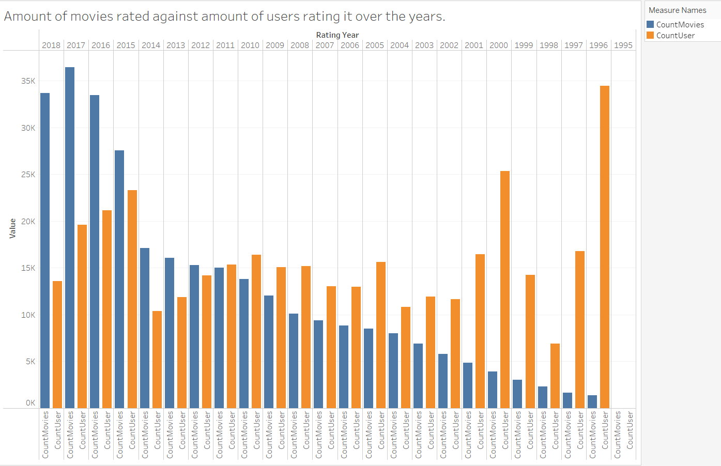
Users rated less over time while movies increased
Number of movies being rated increased in recent years, but number of users rating them have declined.
Users rating in 1996 did not rate again in 2018
1996 each user rated on average 50 movies
Year | # Movies | # Users | Overlap users
1996 | 1,392 | 34,448 | 0
2018 | 33,650 | 13,564 | 0
Notes:
-- count of movies, users in 1996
select ar.year_rate, count(distinct(ar.movieid)) ct_mov, count(distinct(ar.userid)) ct_user from funda.a_ratings ar where ar.year_rate = 1996 group by 1;
-- count of movies, users in 2018
select ar2.year_rate, count(distinct(ar2.movieid)) ct_mov, count(distinct(ar2.userid)) ct_user from funda.a_ratings ar2 where ar2.year_rate = 2018 group by 1;
-- remove where clause for all years’ values
-- Are the same users who rated in 1996 still active in 2018? -- NO
select ar.userid, ar2.userid, ar.movieid, ar.year_rate, ar2.year_rate
from funda.a_ratings ar
inner join (select userid, movieid, year_rate from funda.a_ratings ar where year_rate = 2018) ar2 on ar.userid = ar2.userid
where ar.year_rate = 1996;

Slide 16
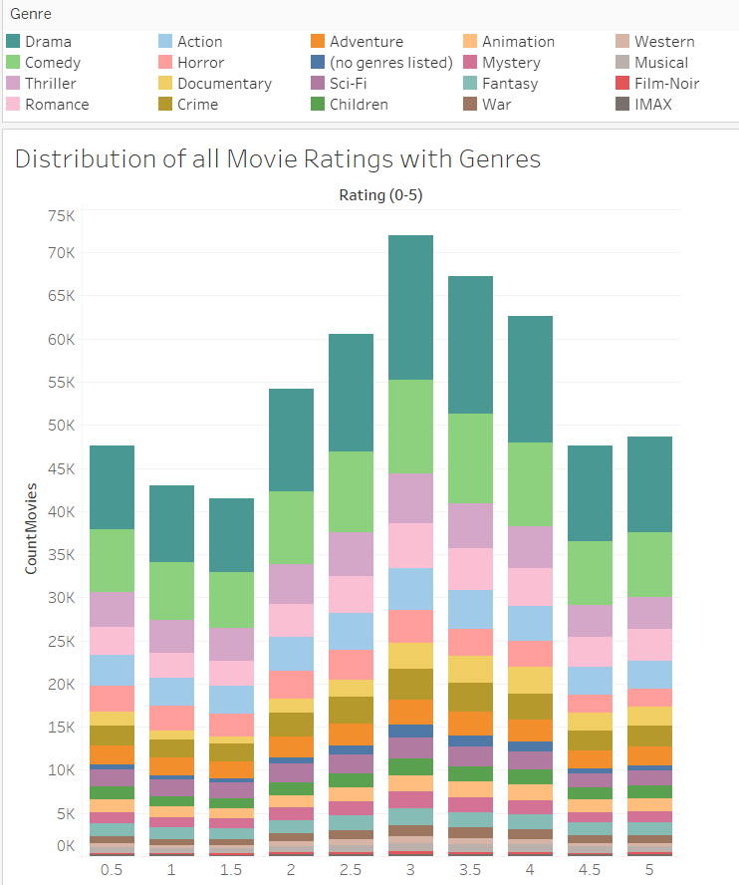
How movies are rated
genres don’t drive the ratings of movies as “good” or “bad”
Documentaries perform higher in rankings than other genres
Notes:
Ppls preferences not good indicator about if it’s a good genre or not

Slide 17
Highest rated genres are “no genre” and “Children”

Slide 18
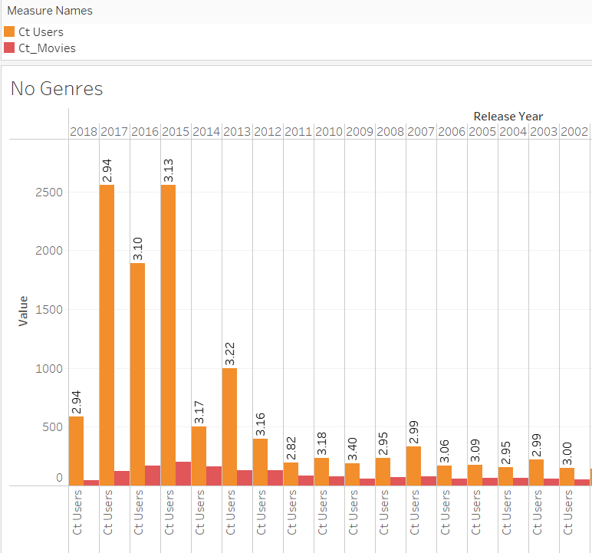
Deep-dive into “no listed genres”
7.3 % of the dataset doesn’t have a genre listed
Highest rated genre with median value of 4.26 when comparing only highly ranked movies
Increased user engagement for recent years of release, but count of movies decline
2018 data shows fewer movies without genre, possible improvement in genre assignment
356 movies without genres tagged with “007” or ‘Bond’, indicating lack of tagging for these type of films
Ave ranked value

Slide 19
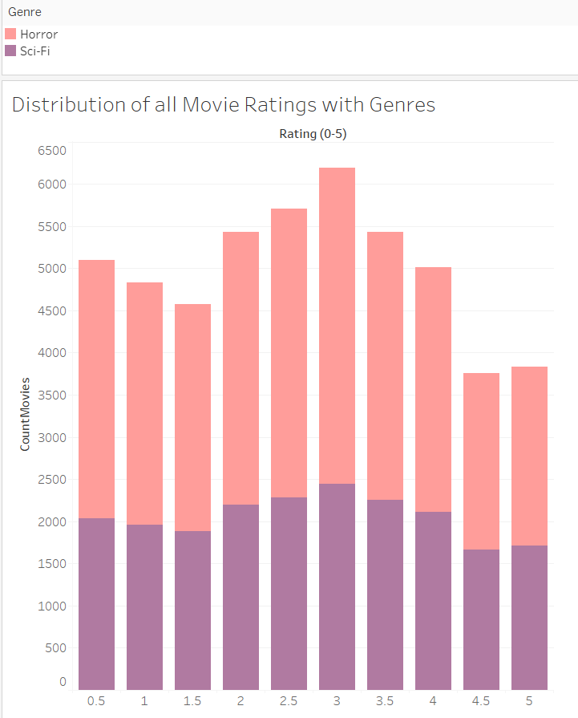
Genres performing the worst were Sci-Fi & Horror

